Slide 1

OS Design When the OS Cannot Be Trusted
Adrien Ghosn – Candidacy Exam
29.06.2017

Slide 2
Outline
Introduction
Challenges
Exokernel
Unikernel
Haven
Research Proposal

Slide 3







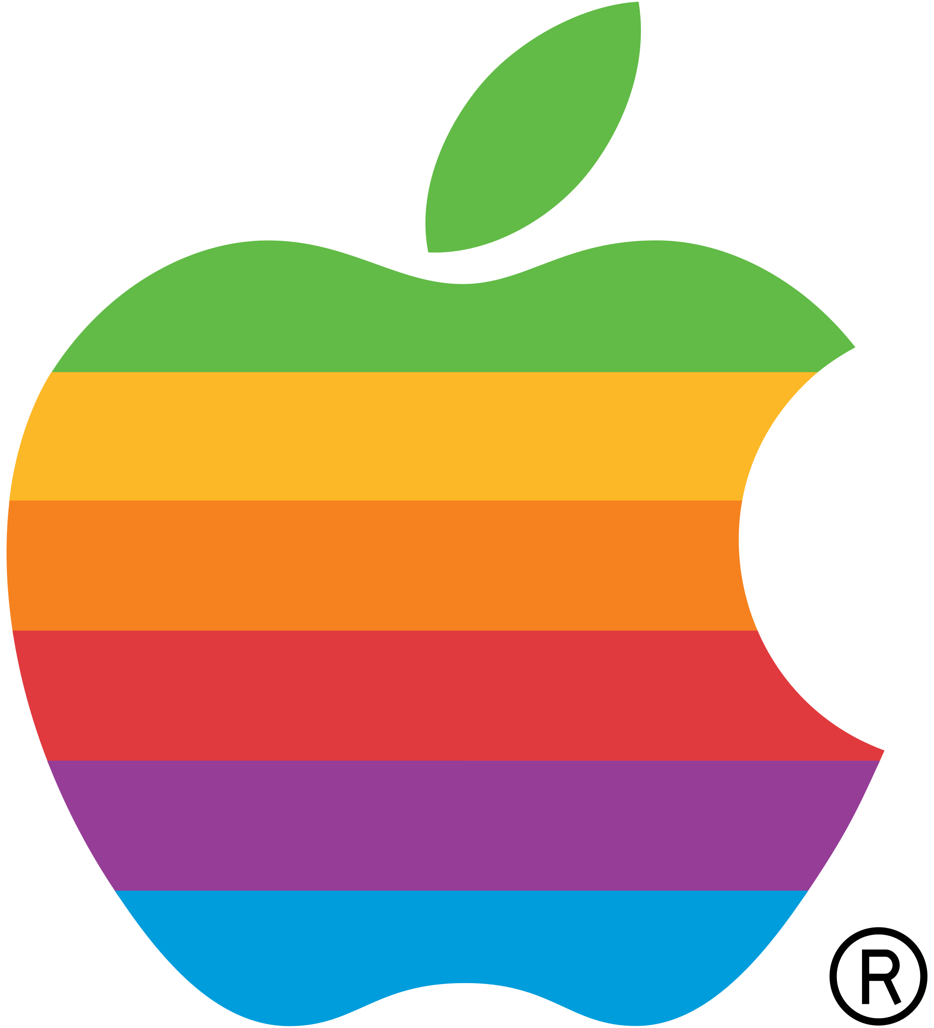





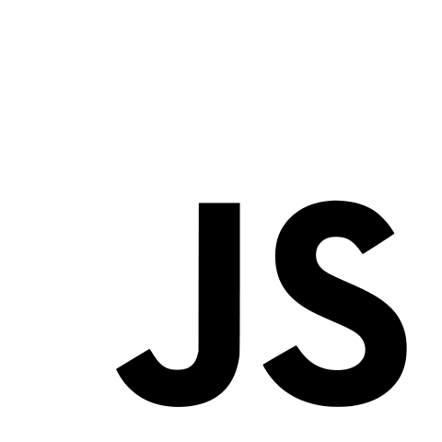












A (biased) Timeline
Computer World:
…
OS abstractions:
POSIX
My Graduation
…
68
70
77
81
85
88
91
95
2050
Notes:
PC -> 1977 for lisa 2, Internet, OO, Cloud services -> 2006, smartphone -> 2007, tablet-> 2010 ipad, linux -> 1991, 1991 WWW, ARPANET 1968
Put lots of things at the very end.
Say number of devices that appear, number of things connected to the internet.

Slide 4

Apps & OS: A Divorce
Non-flexible abstractions
Frameworks.
User-level (re-)implementations.
Non-satisfactory performances
Kernel bypasses.
Security model evolved
“Pirates are back!”
“Don’t trust the Cloud… or ANYTHING!”
“You’re worth less than the data you produce.”

Slide 5
Desired Features
What do we really want from a modern kernel?
Performance for heterogeneous applications.
Ease of deployment, e.g., for Cloud platforms.
Support modern security model, e.g., bi-directional isolation.

Slide 6
How can we achieve this?
Claim: All three requirements can be satisfied with a common set of design principles!
Performance
Deployment
Security
Exokernel
Unikernel
Haven

Slide 7
Exokernel & Performance
End-to-End, Separation of protection & management
Separation of policies & mechanisms

Slide 8


Motivation
Problem: No single, fixed, implementation for high-level abstractions can provide best performance for ALL applications.
So, what can we do now?
Answer: Surrender! Just don’t try to do it!

Slide 9
Exokernel Design
Principle
Translates to…
End-to-End
Sep. protection & management
Avoid management
Sep. policies & mechanisms
App-level physical resource mgmt
Securely expose all hardware
Use physical names
Secure bindings mechanisms
Notes:
Say library operating system

Slide 10
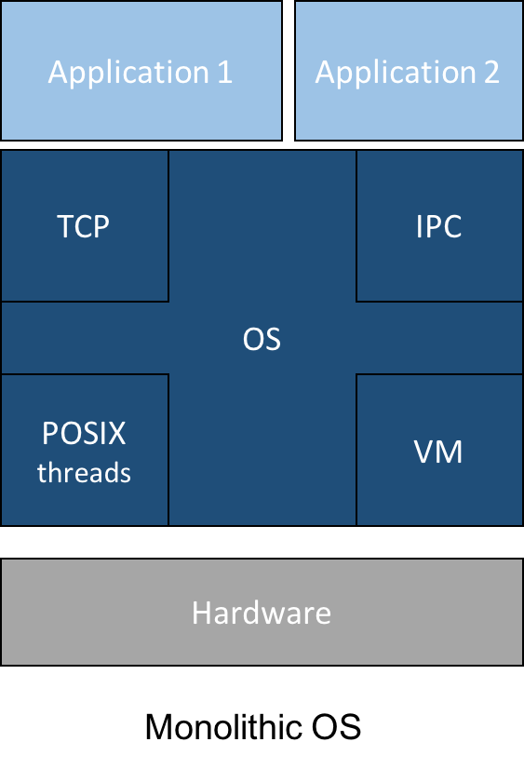
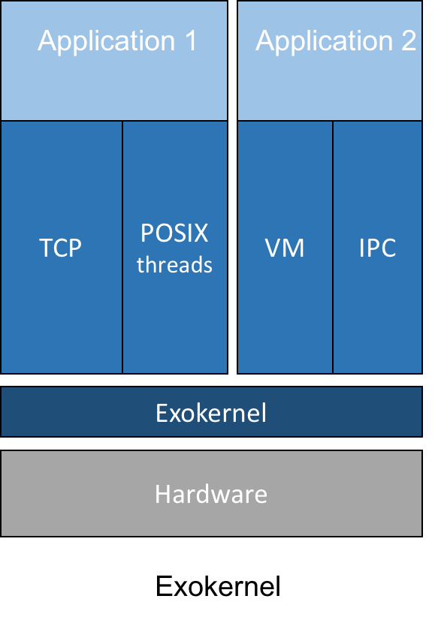
Exokernel Architecture

Slide 11
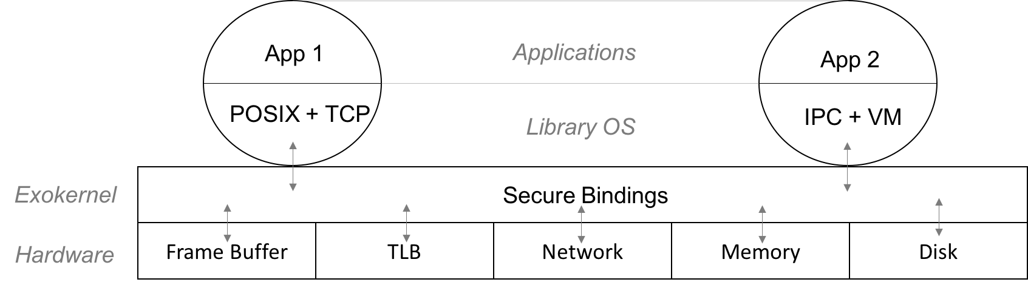
Exokernel Mechanisms
Secure Bindings
Hardware.
Software.
Code Download.
Access time checks
Revocation protocol

Slide 12

Exokernel Discussion
Good
But…
Efficient.
Clear separation between host/guest.
Close to cloud logic.
Heterogeneous hardware makes it unpractical.
Virtualization!

Slide 13
Unikernels & The Cloud
Library operating system, Virtualization, High-level programming languages

Slide 14

Motivation
Problem: Single-purpose VMs deployed in the cloud are not specialized!
Ad-hoc configuration.
Consumes more resources.
Large attack surface.

Slide 15
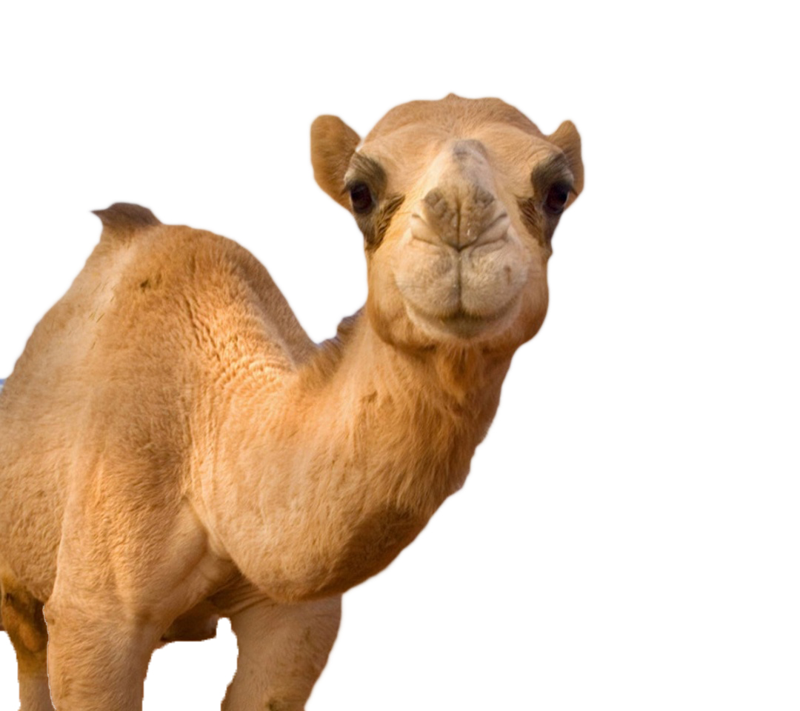

Unikernel Design
Library operating system…
… On top of a Hypervisor!
EVERYTHING in one high-level PL.
Compile application & LibOS together.
Static Analysis & Verification tools.
Type safety

Slide 16
Unikernels
Problem
Solution
Configuration.
Size of appliance.
Security.
Compile time!
Order of hundreds KB!
DCE & Type-safety!

Slide 17
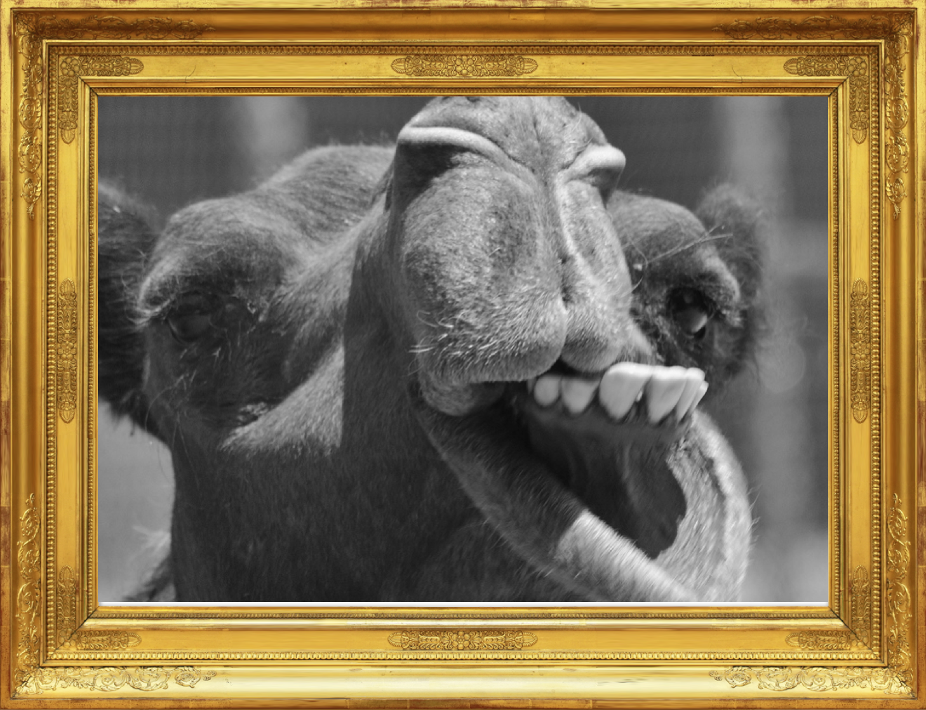
Unikernel Discussion
Good
Less good…
Performance
Portability.
Security.
Deployment & resource usage.
Less fine-grained than exokernel.
OCaml…

Slide 18
Haven & Security
Intel SGX, Separation of policies & mechanisms, Mutual distrust

Slide 19
Motivation…
Why do people use cloud services: IaaS, SaaS, PaaS, WaaS AaaP*?
Because:
How it works:
Fast deployment.
Low start-up cost.
Adaptability.
Sounds fancy.
“You have to share!”
Co-located apps.
“Wrap it!”
Containers, VMs, etc.
“I won’t look… I promise.”
CSP privileged.
*This one is made up.

Slide 20




…De-motivation
But what happens to data confidentiality and IP if we have a…
Corrupted host?
“Pirates are back!”
Malevolent host?
“I need your data for something…”
“Solve the rebus”
What now?

Slide 21


Haven - Thanks Microsoft.
Unmodified legacy applications
Shielded execution
Confidentiality
Integrity
Leverages Intel SGX
Provides feedback.

Slide 22
Intel Software Guard Extension (SGX)
Enclaves
Encrypted portion of address space.
Protected against modification…
… even from privileged code!
CPU in enclave mode
EPC.
Encrypted traffic to DRAM.
Attestation mechanism
App must know about SGX.
Before loading nothing is safe.
Iago attacks.
DoS.

Slide 23
Haven Design
Separation of “policies & mechanisms”
Host is responsible for physical resources.
Guest is responsible for virtual resources.
Restrict interactions between host and guest.
Defend against malicious host EVERYWHERE.

Slide 24
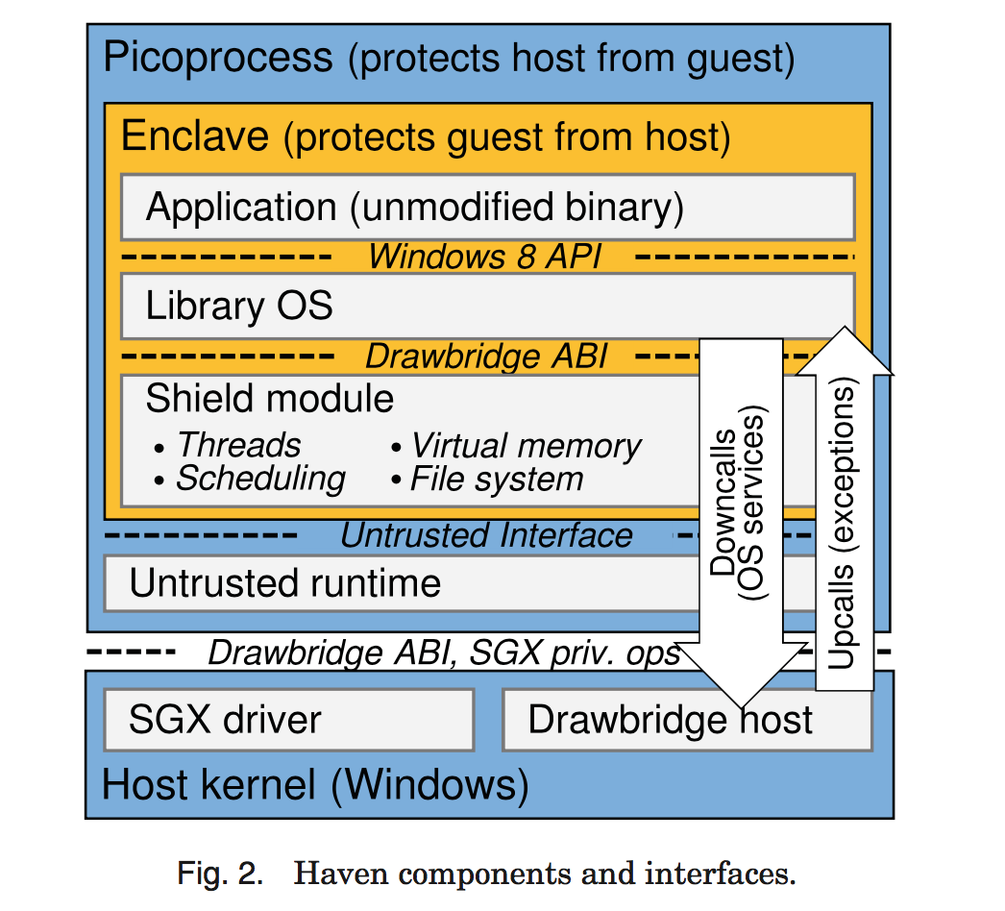
Haven in Practice
Drawbridge
LibOS.
Fully verifiable by application!
Shield module
Kernel primitives.
Validates host services.
First thing loaded.
Untrusted runtime
Forwards calls.
Bootstrap.

Slide 25
Haven Discussion

Slide 26
Haven Discussion
Good
Less good…
Separation between H&G.
Legacy applications.
Attestation.
Performance penalty ~ 2X.
Enclave crossings.
Dynamic memory allocation.
EPC.
Should re-evaluate on hardware.

Slide 27
Comparisons
Exokernel
Unikernel
Share design principles.
Cleaner separation H&G.
Revocation mechanism.
Scarce enclave pages!
Seal memory mappings.
No need for dynamic alloc.
Small size.
Less enclave pages for code&data.
Both allow application-specific implementation of system abstractions!

Slide 28
Conclusion
A modern system must:
Allow application-specific mgmt of resources.
Don’t fix the abstractions!
Separate P&M + P&M.
Take into account modern deployments & hardware setups.
Virtualization has to play a role.
Answer present-day security concerns.
Isolate H&G.
SGX & the likes.
Notes:
So if we summarize, from the exokernel we learned that
we must allow applications to manage their resource and avoid fixing high-level abstractions.
This requires to separate the host from the guest, and

Slide 29
Research Proposal
Rely on modern hardware features to implement such a system.
Performance & flexibility. (P&M + P&M)
Hardware support for virtualization: VT-x, VT-d.
Safely expose to application.
Portability for cloud & hardware setups.
Virtualization helps.
Security.(P&M)
Separate H&G.
SGX transparently integrated.

Slide 30
Thanks!

